Slide 1
Digital Image Processing
Morphological Image Processing

Slide 2
Introduction
Morphology A branch of biology which deals with the form and structure of animals and plants
Mathematical Morphology
A tool for extracting image components that are useful in the representation and description of region shapes
The language of mathematical morphology is Set Theory
2
Notes:
2

Slide 3
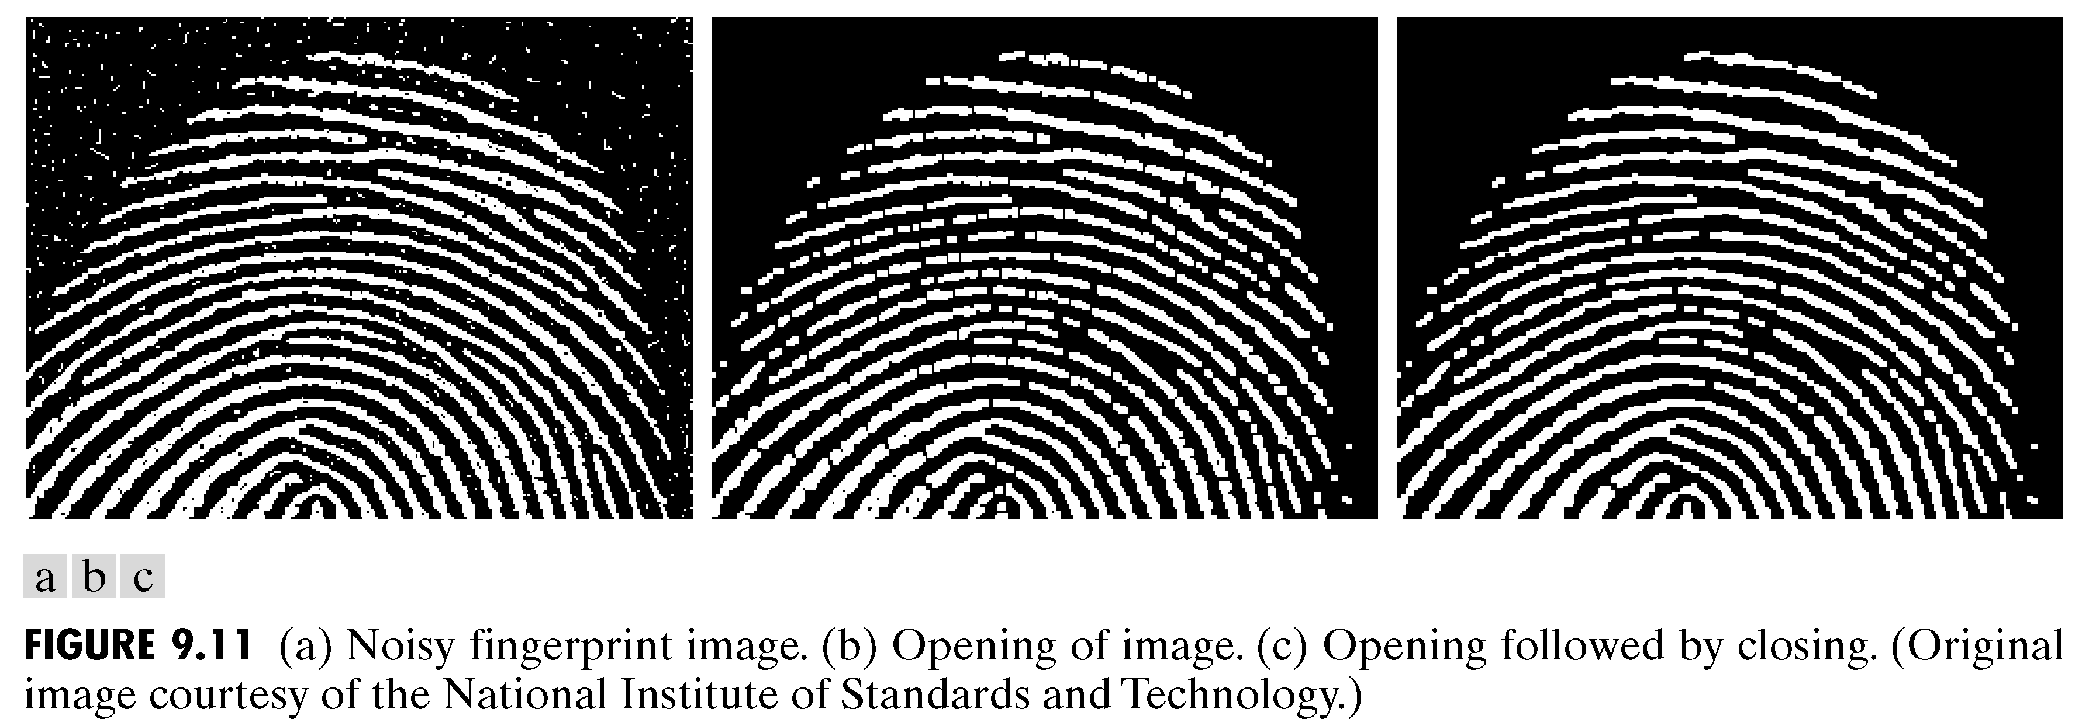
Morphology: Quick Example
Image after segmentation
Image after segmentation and morphological processing
3
Notes:
3

Slide 4
Introduction
Morphological image processing describes a range of image processing techniques that deal with the shape (or morphology) of objects in an image
Sets in mathematical morphology represents objects in an image. E.g. Set of all white pixels in a binary image.
4
Notes:
4

Slide 5

Introduction
foreground:
background
This represents a digital image. Each square is one pixel.
5
Notes:
5

Slide 6
Set Theory
The set space of binary image is Z²
Each element of the set is a 2D vector whose coordinates are the (x,y) of a black (or white, depending on the convention) pixel in the image
The set space of gray level image is Z³
Each element of the set is a 3D vector: (x,y) and intensity level.
NOTE:
Set Theory and Logical operations are covered in: Section 9.1, Chapter # 9, 2nd Edition DIP by Gonzalez Section 2.6.4, Chapter # 2, 3rd Edition DIP by Gonzalez
6
Notes:
6

Slide 7
Set Theory
Let A be a set in Z². if a = (a₁,a₂) is an element of A, then we write
If a is not an element of A, we write
Set representation
Empty or Null set
7
Notes:
7

Slide 8
Set Theory
Subset: if every element of A is also an element of another set B, the A is said to be a subset of B
Union: The set of all elements belonging either to A, B or both
Intersection: The set of all elements belonging to both A and B
8
Notes:
8

Slide 9
Set Theory
Two sets A and B are said to be disjoint or mutually exclusive if they have no common element
Complement: The set of elements not contained in A
Difference of two sets A and B, denoted by A – B, is defined as
i.e. the set of elements that belong to A, but not to B
9
Notes:
9

Slide 10
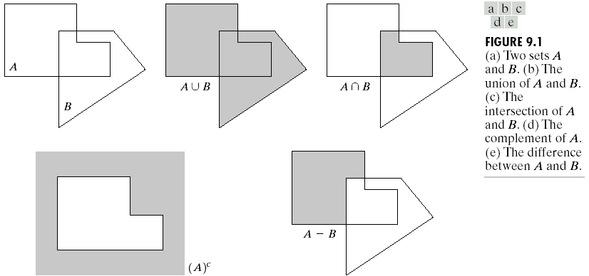
Set Theory
10
Notes:
10

Slide 11
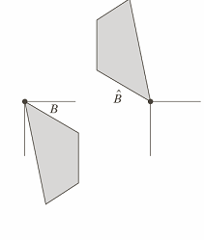
Set Theory
Reflection of set B
i.e. the set of element w, such that w is formed by multiplying each of two coordinates of all the elements of set B by -1
11
Notes:
11

Slide 12
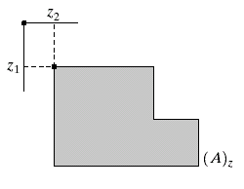
Set Theory
Translation of set A by point z = (z₁,z₂), denoted (A)_{z}, is defined as
12
Notes:
12

Slide 13
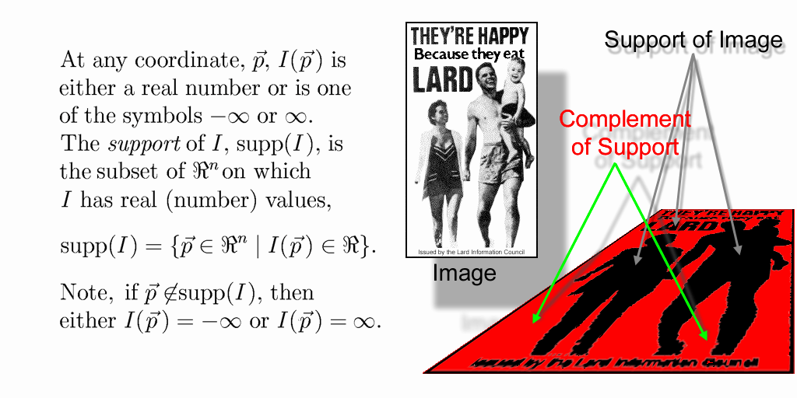
Support of an Image
The support of a binary image, I, is
That is, the support of a binary image is the set of foreground pixel locations within the image plane.
The complement of the support is, therefore, the set of background pixel locations within the image plane.
13
Notes:
13

Slide 14
Structuring Element
A structuring element is a small image – used as a moving window
Example Structuring Elements
Structuring Elements converted to rectangular arrays
14
Notes:
14

Slide 15
Structuring Element
For simplicity we will use rectangular structuring elements with their origin at the middle pixel
0 | 0 | 1 | 0 | 0
0 | 1 | 1 | 1 | 0
1 | 1 | 1 | 1 | 1
0 | 1 | 1 | 1 | 0
0 | 0 | 1 | 0 | 0
1 | 1 | 1
1 | 1 | 1
1 | 1 | 1
0 | 1 | 0
1 | 1 | 1
0 | 1 | 0
15
Notes:
15

Slide 16
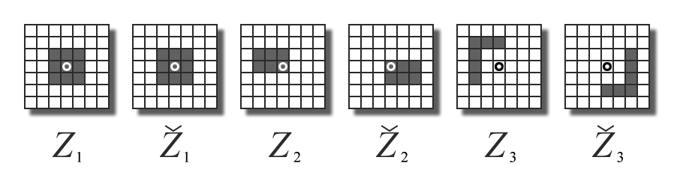
Structuring Element: Reflection
rotated by 180º around its origin.
16
Notes:
16

Slide 17
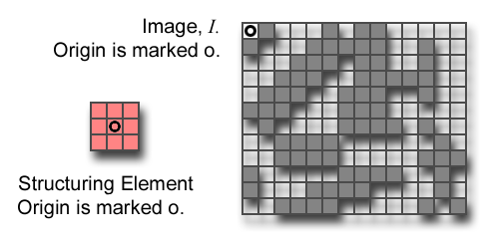
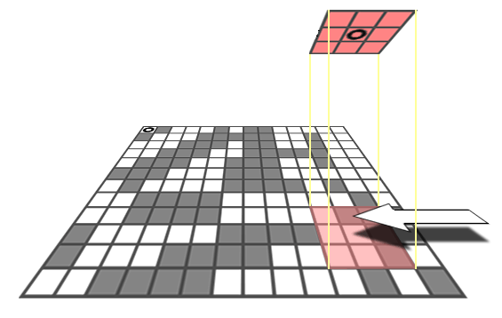
Structuring Element: Translation
Let I be an image and B a SE.
(B)_{z} means that B is moved so that its origin coincides with location z in image I.
(B)_{z} is the translate of B to location z in I.
B
z=(z₁,z₂)
17
Notes:
17

Slide 18
Structuring Elements: Hits & Fits
B
Structuring Element
Fit: All on pixels in the structuring element cover on pixels in the image
Hit: Any on pixel in the structuring element covers an on pixel in the image
A
C
All morphological processing operations are based on these simple ideas
18
Notes:
18

Slide 19
Fitting & Hitting
0 | 0 | 0 | 0 | 0 | 0 | 0 | 0 | 0 | 0 | 0 | 0
0 | 0 | 0 | 1 | 1 | 0 | 0 | 0 | 0 | 0 | 0 | 0
0 | 0 | 1 | 1 | 1 | 1 | 1 | 0 | 0 | 0 | 0 | 0
0 | 1 | 1 | 1 | 1 | 1 | 1 | 1 | 0 | 0 | 0 | 0
0 | 1 | 1 | 1 | 1 | 1 | 1 | 1 | 0 | 0 | 0 | 0
0 | 0 | 1 | 1 | 1 | 1 | 1 | 1 | 0 | 0 | 0 | 0
0 | 0 | 1 | 1 | 1 | 1 | 1 | 1 | 1 | 0 | 0 | 0
0 | 0 | 1 | 1 | 1 | 1 | 1 | 1 | 1 | 1 | 1 | 0
0 | 0 | 0 | 0 | 0 | 1 | 1 | 1 | 1 | 1 | 1 | 0
0 | 0 | 0 | 0 | 0 | 0 | 0 | 0 | 0 | 0 | 0 | 0
1 | 1 | 1
1 | 1 | 1
1 | 1 | 1
B
C
Structuring Element 1
0 | 1 | 0
1 | 1 | 1
0 | 1 | 0
A
Structuring Element 2
19
Notes:
19

Slide 20
Fundamental Operations
Fundamentally morphological image processing is very like spatial filtering
The structuring element is moved across every pixel in the original image to give a pixel in a new processed image
The value of this new pixel depends on the operation performed
There are two basic morphological operations: erosion and dilation
20
Notes:
20

Slide 21

Erosion
21
Notes:
21

Slide 22
Erosion
Definition 1:
The erosion of two sets A and B is defined as:
i.e. The Erosion of A by B is the set of all points z, such that B, translated by z, is contained in A
22
Notes:
22

Slide 23
Erosion
Definition 2:
Erosion of image f by structuring element s is given by f  s
The structuring element s is positioned with its origin at (x, y) and the new pixel value is determined using the rule:
23
Notes:
23

Slide 24
Erosion – How to compute
For each foreground pixel (which we will call the input pixel)
Superimpose the structuring element on top of the input image so that the origin of the structuring element coincides with the input pixel position.
If for every pixel in the structuring element, the corresponding pixel in the image underneath is a foreground pixel, then the input pixel is left as it is.
If any of the corresponding pixels in the image are background, however, the input pixel is also set to background value.
24
Notes:
24

Slide 25
Erosion – How to compute
Erosion with a structuring element of size 3x3
25
Notes:
25

Slide 26
Erosion
B
A

Slide 27
Erosion

Slide 28
Erosion: Example
Original Image
Processed Image With Eroded Pixels
Structuring Element
28
Notes:
28

Slide 29
Erosion: Example
Original Image
Processed Image
Structuring Element
29
Notes:
29

Slide 30
Erosion
Effects
Shrinks the size of foreground (1-valued) objects
Smoothes object boundaries
Removes small objects
Rule for Erosion In a binary image, if any of the pixel (in the neighborhood defined by structuring element) is 0, then output is 0
30
Notes:
30

Slide 31

Erosion: Example 1
Original image
After erosion with a disc of radius 10
After erosion with a disc of radius 5
After erosion with a disc of radius 20
31
Notes:
31

Slide 32
Erosion: Example 2
32
Notes:
32

Slide 33

Erosion: Example 3
Original image
Erosion by 3*3 square structuring element
Erosion by 5*5 square structuring element
Note: In these examples a 1 refers to a black pixel!
33
Notes:
33

Slide 34
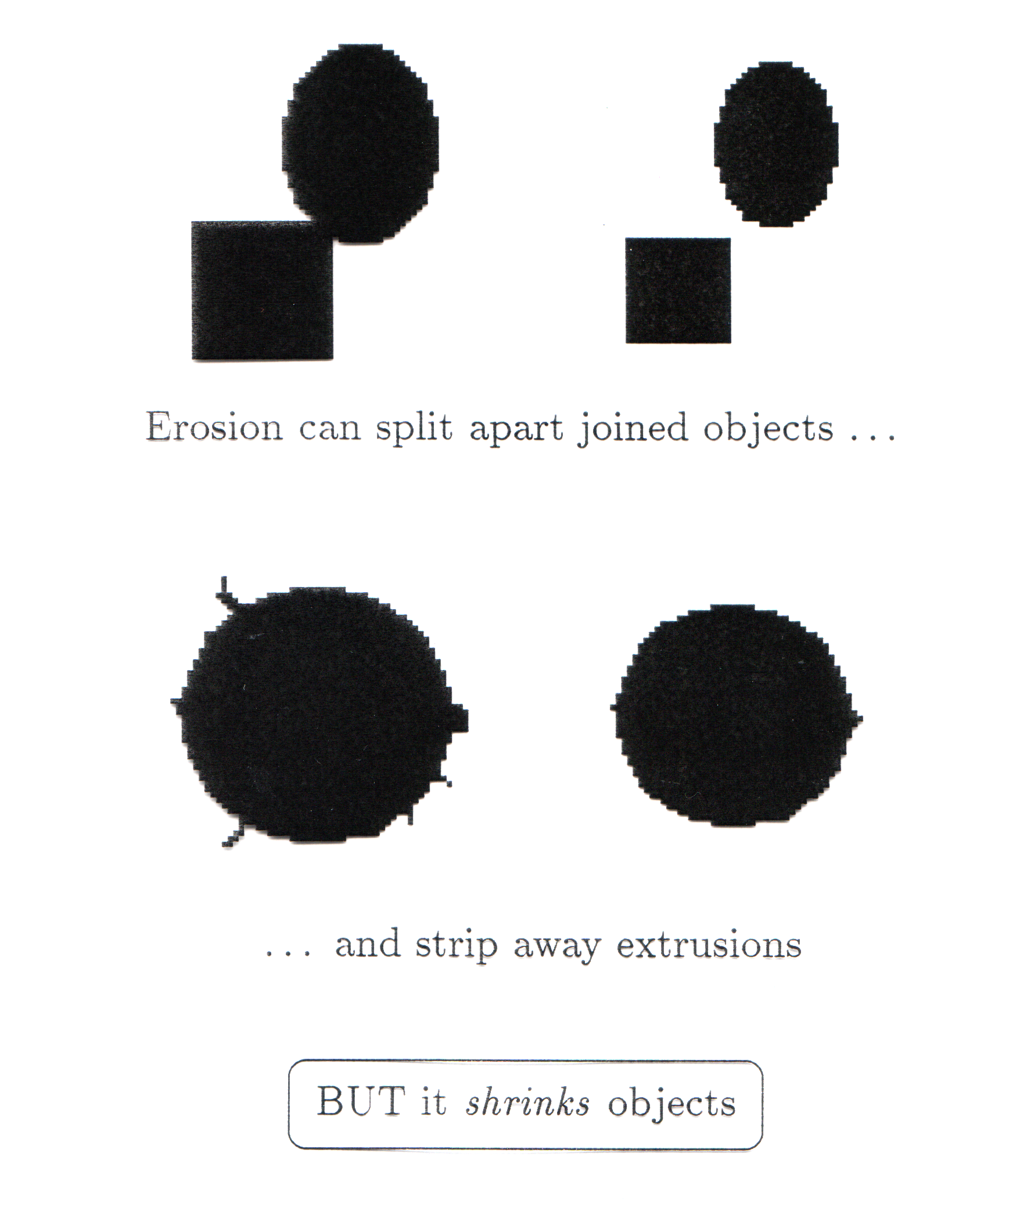
Erosion
Erosion can split apart joined objects
Erosion can strip away extrusions
Watch out: Erosion shrinks objects
34
Notes:
34

Slide 35

Exercise
Count the number of coins in the given image
35
Notes:
35

Slide 36
Exercise: Solution
Binarize the image
Perform Erosion
Use connected component labeling to count the number of coins
36
Notes:
36

Slide 37

Dilation
37
Notes:
37

Slide 38
Dilation
Definition 1:
The dilation of two sets A and B is defined as:
i.e. when the reflection of set B about its origin is shifted by z, the dilation of A by B is the set of all displacements such that overlap A by at least one element
We will only consider symmetric SEs so reflection will have no effect
38
Notes:
38

Slide 39
Dilation
Definition 2:
Dilation of image f by structuring element s is given by
f s
The structuring element s is positioned with its origin at (x, y) and the new pixel value is determined using the rule:
39
Notes:
39

Slide 40
Dilation – How to compute
For each background pixel (which we will call the input pixel)
Superimpose the structuring element on top of the input image so that the origin of the structuring element coincides with the input pixel position
If at least one pixel in the structuring element coincides with a foreground pixel in the image underneath, then the input pixel is set to the foreground value
If all the corresponding pixels in the image are background, however, the input pixel is left at the background value
40
Notes:
40

Slide 41
Dilation: Example
Effect of dilation using a 3×3 square structuring element
41
Notes:
41

Slide 42
Dilation
B
A

Slide 43
Dilation

Slide 44
Dilation: Example
Original Image
Processed Image
Structuring Element
44
Notes:
44

Slide 45
Dilation: Example
Original Image
Processed Image With Dilated Pixels
Structuring Element
45
Notes:
45

Slide 46
Dilation
Effects
Expands the size of foreground(1-valued) objects
Smoothes object boundaries
Closes holes and gaps
Rule for Dilation In a binary image, if any of the pixel (in the neighborhood defined by structuring element) is 1, then output is 1
46
Notes:
46

Slide 47

Dilation: Example 1
Original image
Dilation by 3*3 square structuring element
Dilation by 5*5 square structuring element
Note: In these examples a 1 refers to a black pixel!
47
Notes:
47

Slide 48
Dilation: Example 2
48
Notes:
48

Slide 49
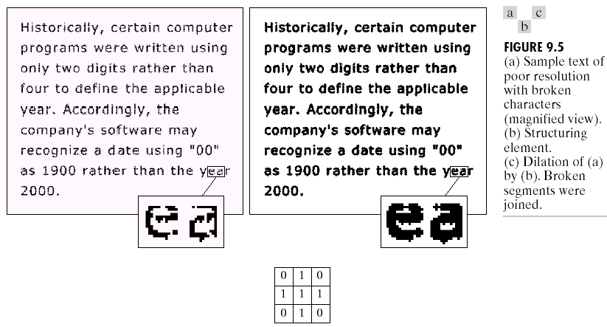
Dilation: Example 3
49
Notes:
49

Slide 50
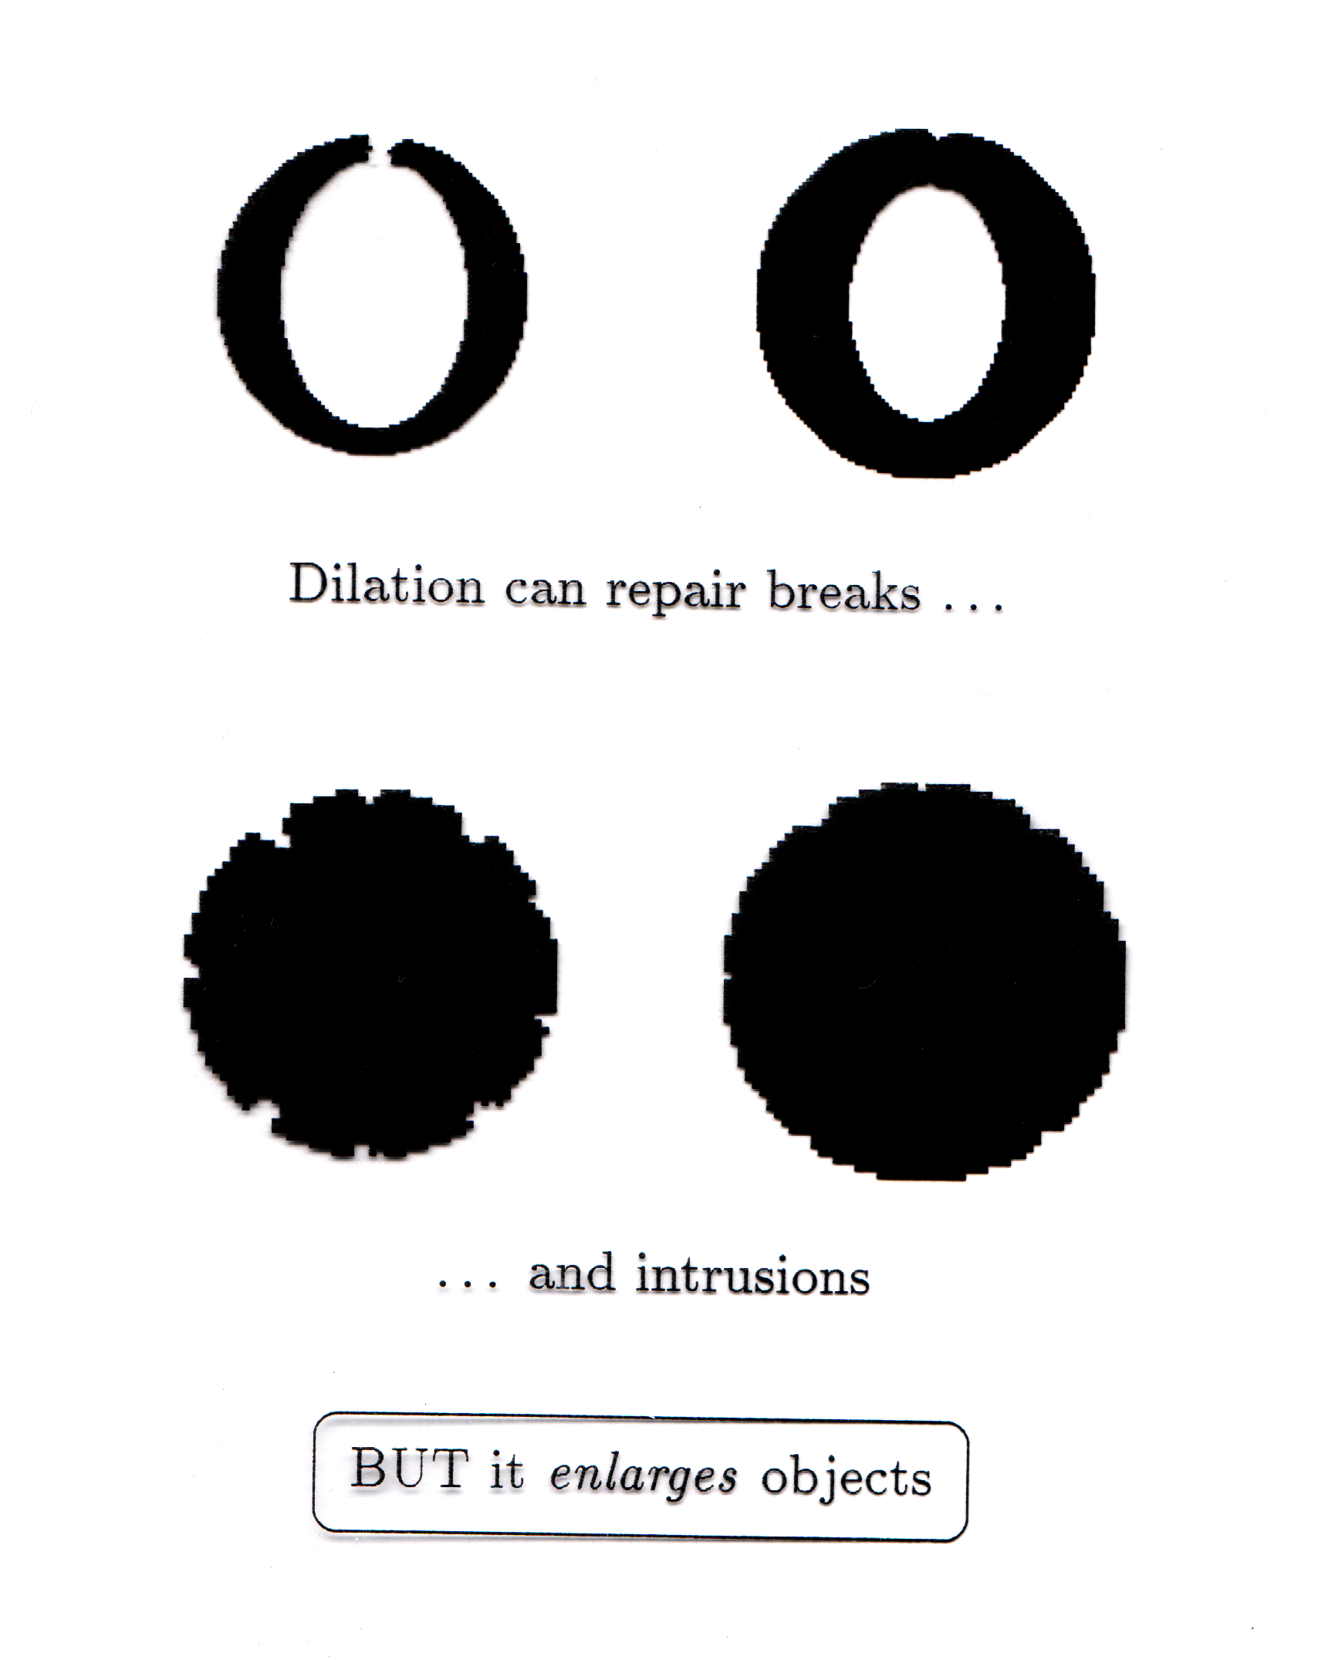
Dilation
Dilation can repair breaks
Dilation can repair intrusions
Watch out: Dilation enlarges objects
50
Notes:
50

Slide 51
Duality relationship between Dilation and Erosion
Dilation and erosion are duals of each other:
For a symmetric structuring element:
It means that we can obtain erosion of an image A by B simply by dilating its background (i.e. A^{c}) with the same structuring element and complementing the result.
51
Notes:
51

Slide 52
Compound Operations
More interesting morphological operations can be performed by performing combinations of erosions and dilations
The most widely used of these compound operations are:
Opening
Closing
52
Notes:
52

Slide 53
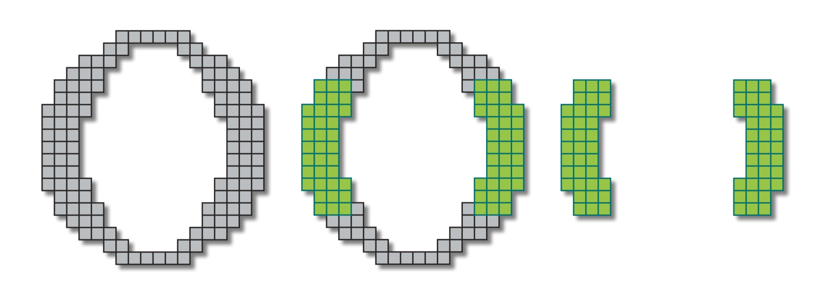
Opening
53
Notes:
53

Slide 54
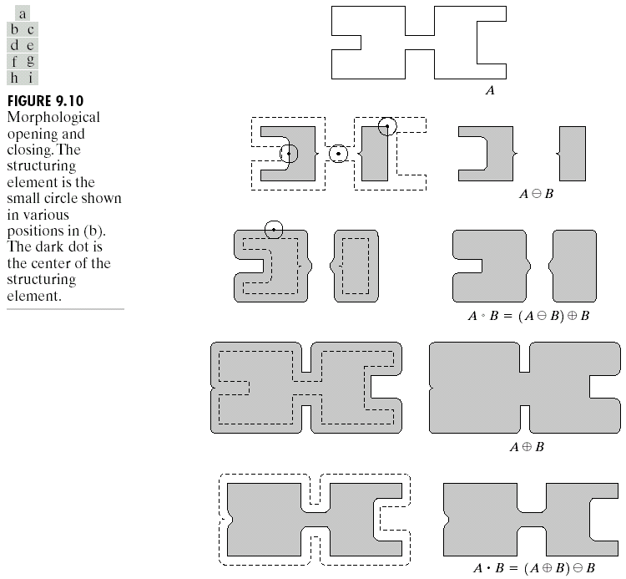
Opening
The opening of image f by structuring element s, denoted by f ○ s is simply an erosion followed by a dilation

Original shape
After erosion
After dilation (opening)
54
Notes:
54

Slide 55

Opening: Example
Original Image
Opening
Breaks narrow joints
Removes ‘Salt’ noise
Image After Opening
55
Notes:
55

Slide 56
Opening: Example
Original Image
Processed Image
Structuring Element
56
Notes:
56

Slide 57

Closing
57
Notes:
57

Slide 58
Closing
The closing of image f by structuring element s, denoted by f • s is simply a dilation followed by an erosion

Original shape
After dilation
After erosion (closing)
58
Notes:
58

Slide 59
Closing: Example
Original Image
Closing
Eliminates small holes
Fills gaps
Removes ‘Pepper’ noise
Image After Closing
59
Notes:
59

Slide 60
Closing: Example
Original Image
Processed Image
Structuring Element
60
Notes:
60

Slide 61
Closing
61
Notes:
61

Slide 62
Opening & Closing
Opening and closing are duals of each others
62
Notes:
62

Slide 63
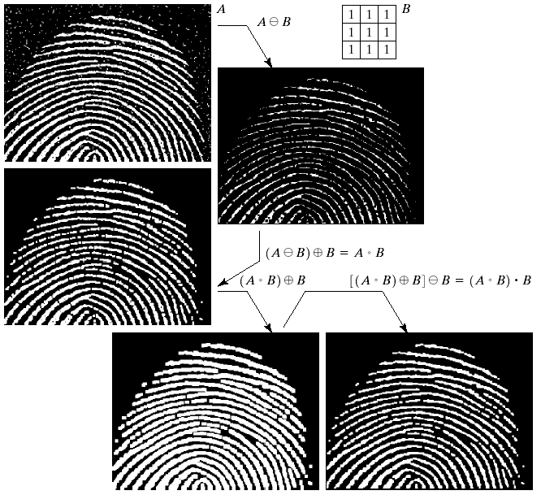

Morphological Processing Example
63
Notes:
63

Slide 64
Run Length Smoothing Algorithm
Text/Graphics Segmentation
64
Notes:
64

Slide 65
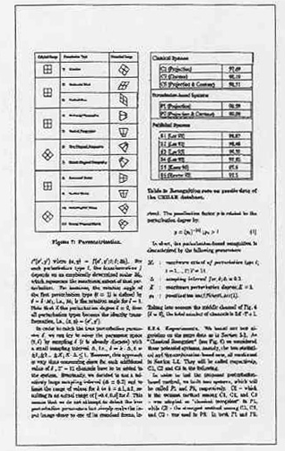
Text/Graphics Segmentation
Separate Text from Graphics
65
Notes:
65

Slide 66
Text/Graphics Segmentation
Run Length Smoothing Algorithm – RLSA
Change runs of white pixels of length below a threshold to black
Black pixels remain unchanged
Example: C=4
X= 0 0 0 1 1 1 0 0 1 1 1 1 1 0 0 0 1 1 1 0
Y= 0 0 0 0 0 0 0 0 1 1 1 1 1 0 0 0 0 0 0 0
66
Notes:
66

Slide 67
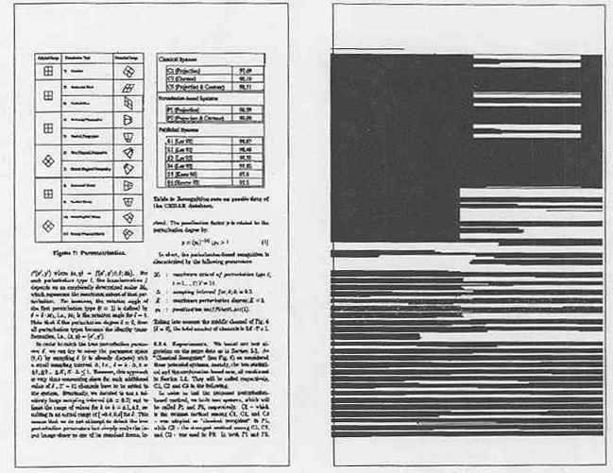
Text/Graphics Segmentation
Horizontal RLSA
67
Notes:
67

Slide 68

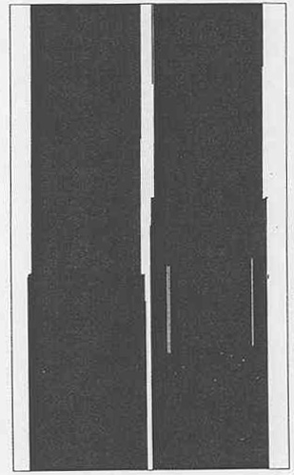
Text/Graphics Segmentation
Vertical RLSA
68
Notes:
68

Slide 69

Text/Graphics Segmentation
Horizontal RLSA
Vertical RLSA
69
Notes:
69

Slide 70

Text/Graphics Segmentation
RLSA - Algorithm
Result of ANDING horizontal and vertical RLS-ed images
70
Notes:
70

Slide 71
Text/Graphics Segmentation
RLSA - Algorithm
Chose RLSA threshold to join characters instead of words
71
Notes:
71

Slide 72
Text/Graphics Segmentation
Word Extraction using RLSA
72
Notes:
72

Slide 73
Text/Graphics Segmentation
73
Notes:
73

Slide 74
Line/Word Extraction
74
Notes:
74
Here is an outline for my presentation.
I am gonna talk about what is content-based retrieval CBR.
I am gonna introduce three major content-based retrieval in multimedia systems, which are CBIR, CBVR and CBAR.
And if time allows, I will briefly mention my proposals to effective CBR.

Slide 75

Line and Word Extraction
Line Extraction?
Horizontal Projection Profile
Vertical Projection Profile of first line
75
Notes:
75

Slide 76
Line and Word Extraction
Line Extraction?
Horizontal Projection Profile
Vertical Projection Profile of first line
76
Notes:
76

Slide 77
Line and Word Extraction
Projection Profiles
Horizontal Projection Profile
Vertical Projection Profile of first line
77
Notes:
77

Slide 78
Hit-or-Miss Transform
A tool for shape detection or for the detection of a disjoint region in an image
Idea
Suppose we have a binary image that contains certain shapes (circles, squares, lines, etc,….) called image A
We use another image or matrix to search image A for a particular pattern of bits. We will call this pattern “shape B”
We then search image A for shape B
Whenever there is a ‘fit’, we indicate where the center of shape B was on image A.
78
Notes:
78

Slide 79
Hit-or-Miss Transform
A tool for shape detection or for the detection of a disjoint region in an image
Idea
Suppose we have a binary image that contains certain shapes (circles, squares, lines, etc,….) called image A
We use another image or matrix to search image A for a particular pattern of bits. We will call this pattern “shape B”
We then search image A for shape B
Whenever there is a ‘fit’, we indicate where the center of shape B was on image A.
Watch out: We actually look for ‘fits’ but we will be calling them ‘hits’ when talking about hit-or-miss transform
79
Notes:
79

Slide 80
Hit-or-Miss Transform
Structuring Element
So far we have considered the SEs where 0s are treated as Don’t Cares i.e. we focus on the 1s only
 | 1
1 | 1 | 1
 | 1
0 | 1 | 0
1 | 1 | 1
0 | 1 | 0
80
Notes:
80

Slide 81
Hit-or-Miss Transform
Extended Structuring Element
Now we will distinguish between the 0s and the Don’t cares
1 | 1 | 1
 | 0
 | 0
E.g. For a ‘fit’ the 0s of SE should match with 0s of the underlying image
81
Notes:
81

Slide 82
Hit-or-Miss Transform
Extended Structuring Element: Example
0 | 0 | 0 | 0 | 0 | 0 | 0 | 0
0 | 0 | 1 | 1 | 1 | 0 | 0 | 0
0 | 0 | 0 | 0 | 1 | 1 | 1 | 0
0 | 1 | 0 | 0 | 1 | 1 | 1 | 1
0 | 1 | 1 | 1 | 1 | 1 | 0 | 1
0 | 0 | 1 | 1 | 1 | 1 | 0 | 1
1
1
1
0
0
Erosion Recap: Slide the SE on the image and look for the ‘fits’
82
Notes:
82

Slide 83
Hit-or-Miss Transform
Extended Structuring Element: Example
0 | 0 | 0 | 0 | 0 | 0 | 0 | 0
0 | 0 | 1 | 1 | 1 | 0 | 0 | 0
0 | 0 | 0 | 0 | 1 | 1 | 1 | 0
0 | 1 | 0 | 0 | 1 | 1 | 1 | 1
0 | 1 | 1 | 1 | 1 | 1 | 0 | 1
0 | 0 | 1 | 1 | 1 | 1 | 0 | 1
‘Fit’ encountered
1
1
1
0
0
83
Notes:
83

Slide 84
Hit-or-Miss Transform
Extended Structuring Element: Example
0 | 0 | 0 | 0 | 0 | 0 | 0 | 0
0 | 0 | 1 | 1 | 1 | 0 | 0 | 0
0 | 0 | 0 | 0 | 1 | 1 | 1 | 0
0 | 1 | 0 | 0 | 1 | 1 | 1 | 1
0 | 1 | 1 | 1 | 1 | 1 | 0 | 1
0 | 0 | 1 | 1 | 1 | 1 | 0 | 1
1
1
1
0
0
‘Fit’ encountered
84
Notes:
84

Slide 85
Hit-or-Miss Transform
Extended Structuring Element: Example
0 | 0 | 0 | 0 | 0 | 0 | 0 | 0
0 | 0 | 1 | 1 | 1 | 0 | 0 | 0
0 | 0 | 0 | 0 | 1 | 1 | 1 | 0
0 | 1 | 0 | 0 | 1 | 1 | 1 | 1
0 | 1 | 1 | 1 | 1 | 1 | 0 | 1
0 | 0 | 1 | 1 | 1 | 1 | 0 | 1
0 | 0 | 0 | 0 | 0 | 0 | 0 | 0
0 | 0 | 0 | 0 | 0 | 0 | 0 | 0
0 | 0 | 0 | 1 | 0 | 0 | 0 | 0
0 | 0 | 0 | 0 | 0 | 0 | 0 | 0
0 | 0 | 0 | 0 | 0 | 0 | 1 | 0
0 | 0 | 0 | 0 | 0 | 0 | 0 | 0
1
1
1
0
0
What we actually did???
85
Notes:
85

Slide 86
Hit-or-Miss Transform
We have searched the pattern in the structuring element in the image
0 | 0 | 0 | 0 | 0 | 0 | 0 | 0
0 | 0 | 0 | 0 | 0 | 0 | 0 | 0
0 | 0 | 0 | 1 | 0 | 0 | 0 | 0
0 | 0 | 0 | 0 | 0 | 0 | 0 | 0
0 | 0 | 0 | 0 | 0 | 0 | 1 | 0
0 | 0 | 0 | 0 | 0 | 0 | 0 | 0
Output: The center of the pattern is 1 and rest everything is 0
86
Notes:
86

Slide 87
Hit-or-Miss Transform
Example: Search a 100x100 pixel square in an image
How do we search?
Take an image of size 100x100 (B) representing a white square
We search the pattern in the input image (A)
If found, we have a “fit”. We mark the center of the “fit” with a white pixel
In the above example, there would be only 1 fit
87
Notes:
87

Slide 88
Hit-or-Miss Transform
Do you find any problem with this?
If we search for a 100x100 pixel square in an image we will have a positive response for all squares greater than 100x100 as well
Shape / pattern
Image
The pattern will fit at different places
Need some thing here
88
Notes:
88

Slide 89
Hit-or-Miss Transform
We will limit our discussion to this simple version only
89
Notes:
89

Slide 90
Morphological Algorithms
Using the simple technique we have looked at so far we can begin to consider some more interesting morphological algorithms
We will look at:
Boundary extraction
Region filling
Extraction of connected components
There are lots of others as well though:
Thinning/thickening
Skeletonization
90
Notes:
90

Slide 91
Boundary Extraction
The boundary of set A denoted by β(A) is obtained by first eroding A by a suitable structuring element B and then taking the difference between A and its erosion.
91
Notes:
91

Slide 92
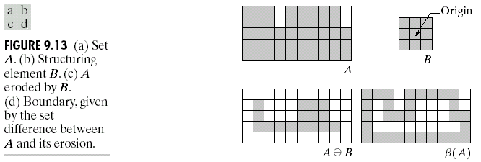
Boundary Extraction
92
Notes:
92

Slide 93
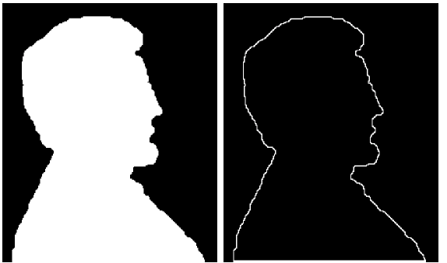
Boundary Extraction
A simple image and the result of performing boundary extraction using a square 3*3 structuring element
Original Image
Extracted Boundary
93
Notes:
93

Slide 94
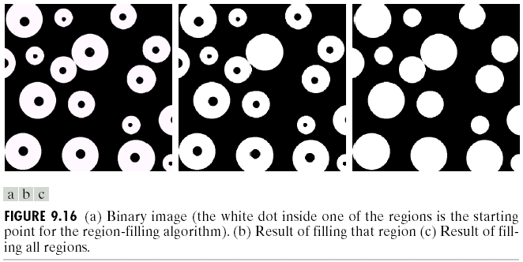
Region (hole) Filling
Given a pixel inside a boundary, region filling attempts to fill that boundary with object pixels (1s)
Given a point inside here, can we fill the whole circle?
94
Notes:
94

Slide 95
Region Filling
Let A is a set containing a subset whose elements are 8-connected boundary points of a region, enclosing a background region i.e. hole
If all boundary points are labeled 1 and non boundary points are labeled 0, the following procedure fills the region:
Start from a known point p and taking X₀= p,
Then taking the next values of X_{k} as:
B is suitable structuring element
Terminate iterations if X_{k+1} = X_{k}
The set union of X_{k} and A contains the filled set and its boundaries.
Inside the boundary
95
Notes:
95

Slide 96
Region Filling
0 | 0 | 0 | 0 | 0 | 0 | 0
0 | 1 | 1 | 1 | 1 | 1 | 0
0 | 1 | 0 | 0 | 0 | 1 | 0
0 | 1 | 0 | 0 | 0 | 1 | 0
0 | 1 | 0 | 0 | 0 | 1 | 0
0 | 1 | 1 | 1 | 1 | 1 | 0
0 | 0 | 0 | 0 | 0 | 0 | 0
1 | 1 | 1 | 1 | 1 | 1 | 1
1 | 0 | 0 | 0 | 0 | 0 | 1
1 | 0 | 1 | 1 | 1 | 0 | 1
1 | 0 | 1 | 1 | 1 | 0 | 1
1 | 0 | 1 | 1 | 1 | 0 | 1
1 | 0 | 0 | 0 | 0 | 0 | 1
1 | 1 | 1 | 1 | 1 | 1 | 1
0 | 1 | 0
1 | 1 | 1
0 | 1 | 0
B
A
A^{c}

Slide 97
Region Filling
0 | 0 | 0 | 0 | 0 | 0 | 0
0 | 0 | 0 | 0 | 0 | 0 | 0
0 | 0 | 1 | 0 | 0 | 0 | 0
0 | 0 | 0 | 0 | 0 | 0 | 0
0 | 0 | 0 | 0 | 0 | 0 | 0
0 | 0 | 0 | 0 | 0 | 0 | 0
0 | 0 | 0 | 0 | 0 | 0 | 0
0 | 0 | 0 | 0 | 0 | 0 | 0
0 | 0 | 1 | 0 | 0 | 0 | 0
0 | 1 | 1 | 1 | 0 | 0 | 0
0 | 0 | 1 | 0 | 0 | 0 | 0
0 | 0 | 0 | 0 | 0 | 0 | 0
0 | 0 | 0 | 0 | 0 | 0 | 0
0 | 0 | 0 | 0 | 0 | 0 | 0
0 | 1 | 0
1 | 1 | 1
0 | 1 | 0

Slide 98
Region Filling
0 | 0 | 0 | 0 | 0 | 0 | 0
0 | 0 | 1 | 0 | 0 | 0 | 0
0 | 1 | 1 | 1 | 0 | 0 | 0
0 | 0 | 1 | 0 | 0 | 0 | 0
0 | 0 | 0 | 0 | 0 | 0 | 0
0 | 0 | 0 | 0 | 0 | 0 | 0
0 | 0 | 0 | 0 | 0 | 0 | 0
1 | 1 | 1 | 1 | 1 | 1 | 1
1 | 0 | 0 | 0 | 0 | 0 | 1
1 | 0 | 1 | 1 | 1 | 0 | 1
1 | 0 | 1 | 1 | 1 | 0 | 1
1 | 0 | 1 | 1 | 1 | 0 | 1
1 | 0 | 0 | 0 | 0 | 0 | 1
1 | 1 | 1 | 1 | 1 | 1 | 1
0 | 0 | 0 | 0 | 0 | 0 | 0
0 | 0 | 0 | 0 | 0 | 0 | 0
0 | 0 | 1 | 1 | 0 | 0 | 0
0 | 0 | 1 | 0 | 0 | 0 | 0
0 | 0 | 0 | 0 | 0 | 0 | 0
0 | 0 | 0 | 0 | 0 | 0 | 0
0 | 0 | 0 | 0 | 0 | 0 | 0

Slide 99
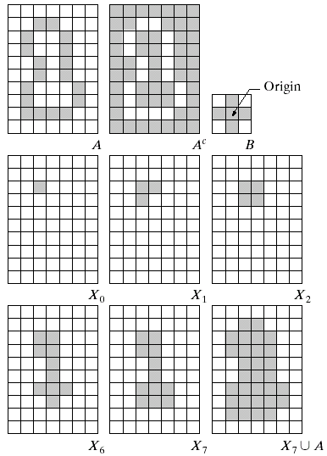
Region Filling
NOTE: The intersection of dilation and the complement of A limits the result to inside the region of interest
99
Notes:
99

Slide 100
Region Filling: Example
Original Image
One Region Filled
All Regions Filled
100
Notes:
100

Slide 101
Extraction of Connected Components (CCs)
Let Y represents a connected component contained in A and the point p of the Y is known.
The following procedure iteratively finds all the elements of Y:
Start from a known point p and taking X₀= p,
Then taking the next values of X_{k} as:
B is a suitable structuring element
Algorithm converges if X_{k} = X_{k-1}
The component Y is given as Y = X_{k}
101
Notes:
101

Slide 102
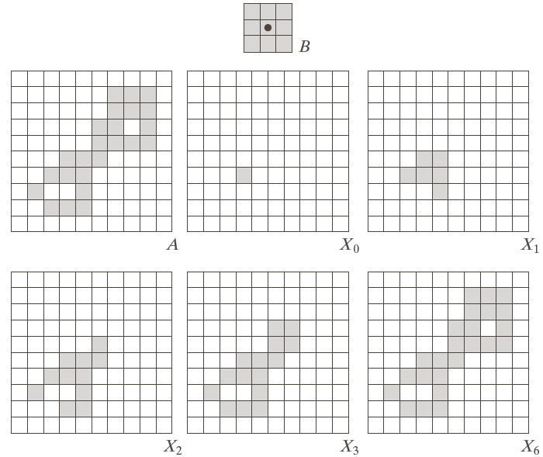
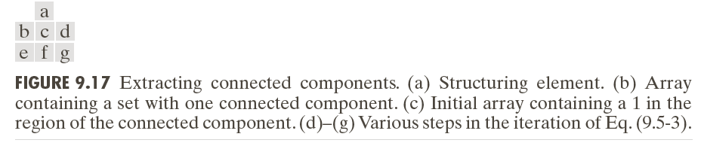
Extraction of CCs
Extraction of CCs: Example
102
Notes:
102

Slide 103

Extraction of CCs: Example
103
Notes:
103

Slide 104
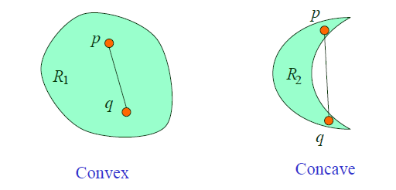
Convex Hull
Convex set A set A is said to be convex if any straight line segment joining two points of A lies within A
Example: R₁ is convex as line segment pq lies within set R₁
104
Notes:
104

Slide 105
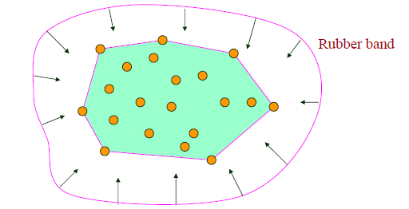
Convex Hull
Convex Hull Convex hull H of a set S is the smallest convex set containing S
Rubber band example:
Convex Hull
105
Notes:
105

Slide 106
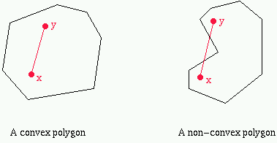
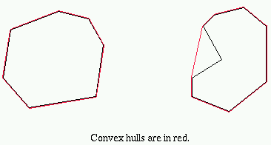

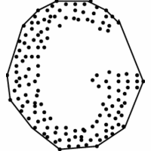
Convex Hull
106
Notes:
106

Slide 107
Convex Hull
To find the Convex Hull C(A) of a set A the following simple morphological algorithm can be used:
Let B^{i}, where i = 1, 2, 3, 4, represent four structuring elements
Implement:
Starting with:
Repeat 2nd step until convergence, i.e.
Convex Hull C(A) is given by:
*
107
Notes:
107

Slide 108

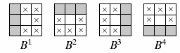
Convex Hull
Pick the first SE
Start At:
Find:
*
*
Until Convergence
*
108
Notes:
108

Slide 109
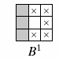
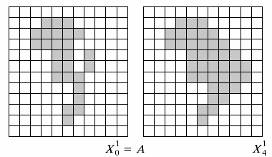
Convex Hull
*
Convergence after four iterations
Call it D¹
109
Notes:
109

Slide 110
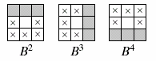
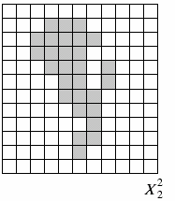
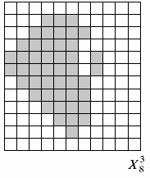
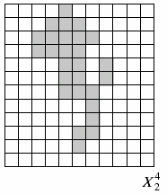
Convex Hull
Repeat the same process for B², B³ and B⁴
*
D²
D³
D⁴
110
Notes:
110

Slide 111
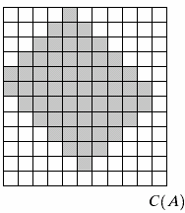
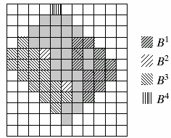
Convex Hull
Take the union of all D^{i} to get the convex hull of A
111
Notes:
111

Slide 112
Acknowledgements
Digital Image Processing”, Rafael C. Gonzalez & Richard E. Woods, Addison-Wesley, 2002
Peters, Richard Alan, II, Lectures on Image Processing, Vanderbilt University, Nashville, TN, April 2008
Brian Mac Namee, Digitial Image Processing, School of Computing, Dublin Institute of Technology
Computer Vision for Computer Graphics, Mark Borg
Material in these slides has been taken from, the following resources
112
Notes:
112

